Slide 1

Reinforcement Learning in a Neurally Controlled Robot Using Dopamine Modulated STDP
Aug 8, 2023
Sungmin Yoon
By Richard Evans

Slide 2
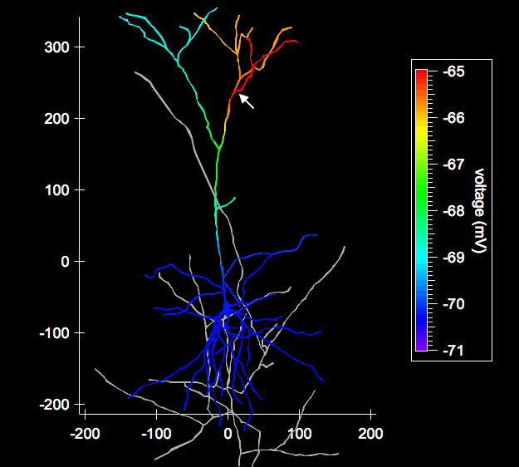
Index
Neurons
RL in Brain
SNN controlled robot
Discussion

Slide 3
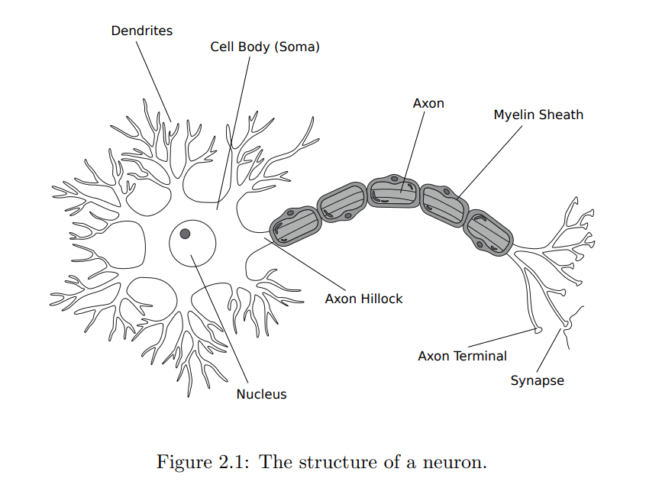
Neurons
General architecture
Input from several
Pre-synaptic neurons
Fire!
Excitatory
or
Inhibitory
→ Chemical(Glu, GABA..)
→ Refractory period
Notes:
This image show the general architecture of neurons. And I’ll explain how the neuron work.
First Each neurons receives ~ from dendrites
Which affect the membrane potential of post-synaptic neurons.
Once the membrane potential at the Axon Hillock hits the threshold, voltage gated ion channel open, which cause neuron to rapidly depolarize. This is Fire.
Wave is delivered through Axon, and when it reaches the axon terminal, it is converted to chemical signal, and move through synapse to other neurons.
After firing, each neuron have the refractory period. Refractory period is the time that neurons can not fire.
There is Two main type of neurons which is excitatory and inhibitory. Excitatory neuron have the effect of raising membrane potential of post-synaptic neuron, whereas inhibitory neuron affect the other way.
There are general term of neuro-science, which are EPSP and IPSP.

Slide 4
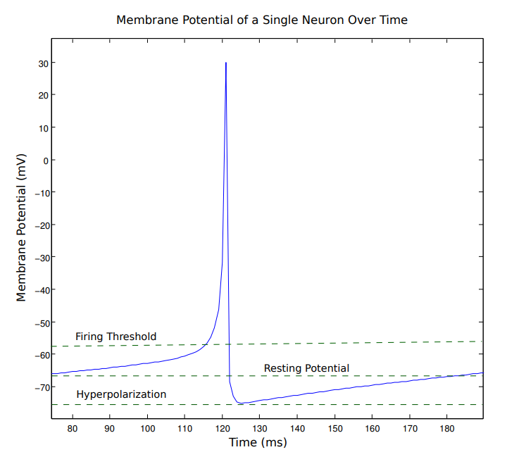
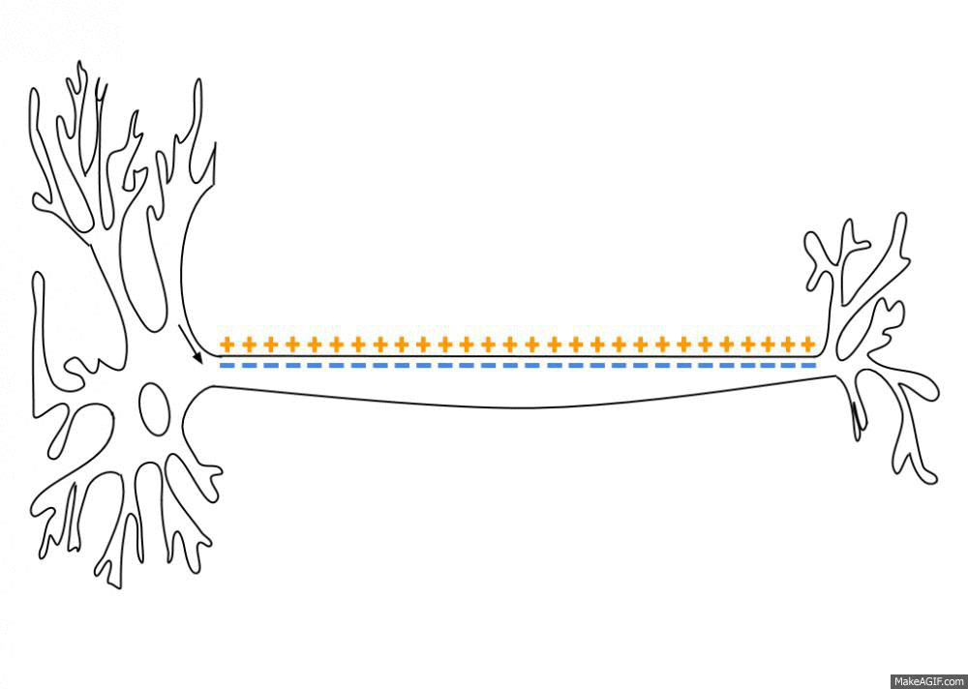
Neurons
Notes:
This graph show the membrane potential of neuron through the time. There is constant input current, and when the membrane potential hit the threshold, it becomes fire. Which mean, the neuron make spike.
After making spike, the depolarized neuron have falling phase, and hyperpolarize, and reset to the resting potential.

Slide 5
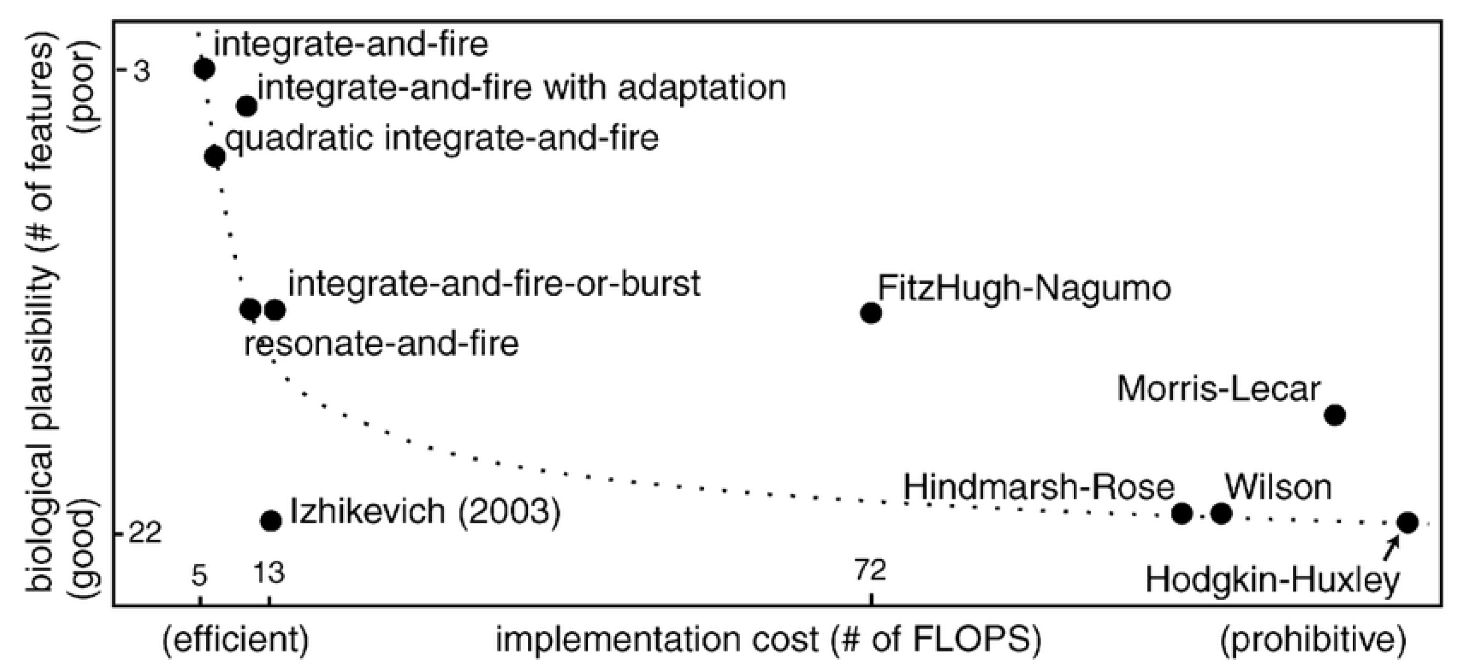
Neurons
Hodgkin-Huxley Model
Izhikevich Model
LIF Model
Notes:
And I’ll talk about the neuron model. There are three type of neuron model, ~.

Slide 6

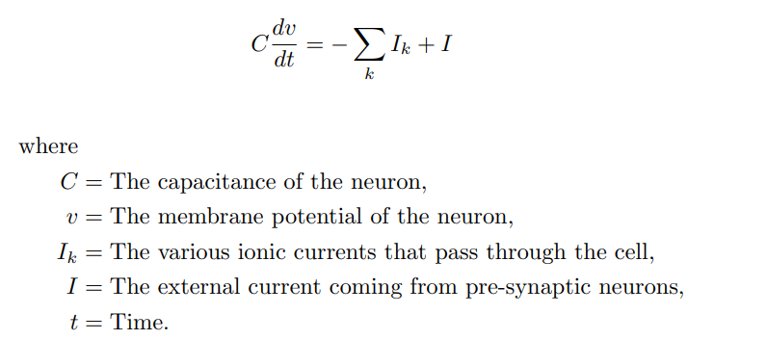
Neurons
Hodgkin-Huxley Model
Notes:
Hodgkin-Huxley model is developed by experiment of giant–squid, so it is very biologically accurate.
But it has heavy computational cost.
The figure from paper is very simple version of this model.
Definition of v and I here is used when we see the izikevich model. V is ~ I is ~

Slide 7
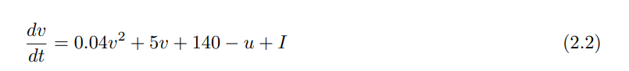
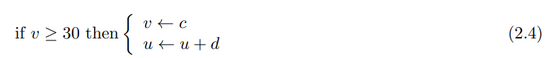
Neurons
Izhikevich Model
Notes:
The mainly addressed model in this paper is Izhikevich model. It is good compromise between biological accuracy and computational cost. As you see in the figure 2.2, the equation is non-linear, but simple enough.
U Is ~ . And four variable a,b,c,d are the parameter of neurons. Using These four variable, We can make various version of neuron by the izhkevich model. While as the LIF model can only implement 3 types.

Slide 8
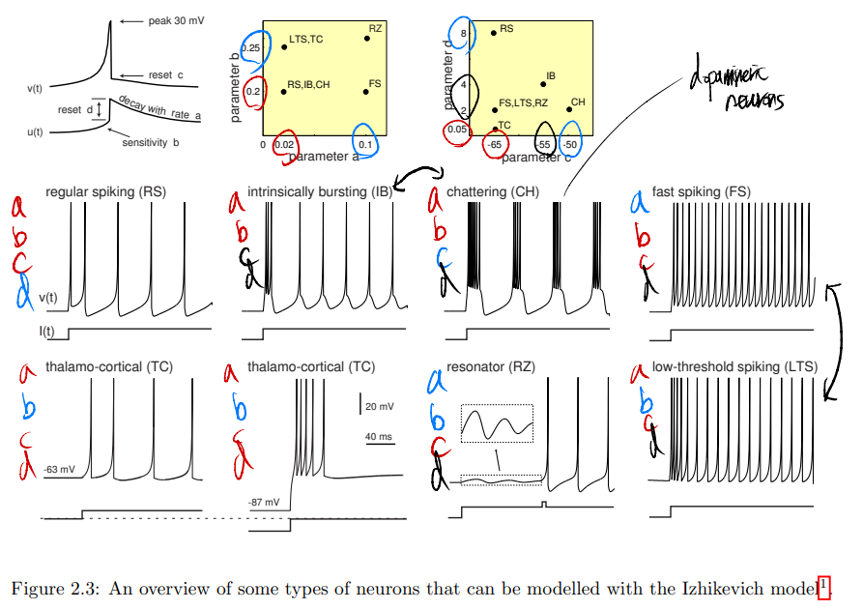
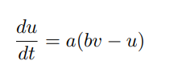
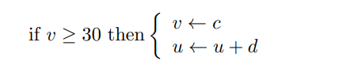
Neurons
Izhikevich Model
Notes:
This page shows the some types of ~
I’ll explain this after the English presentation.

Slide 9
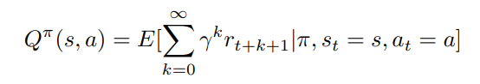
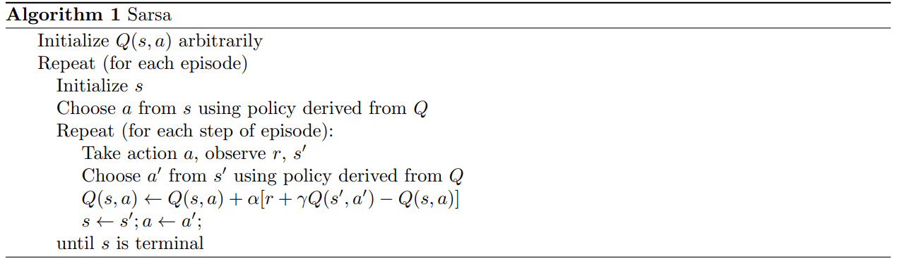
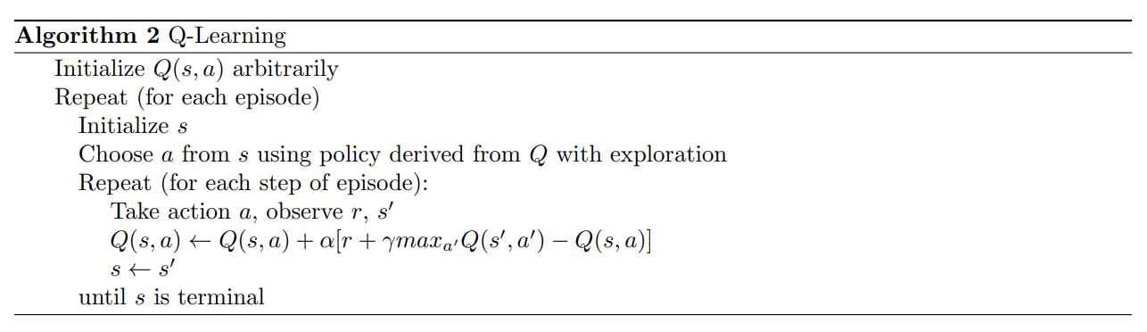
Reinforcement Learning
Markov property
Q-function
Sarsa
Q-Learning

Slide 10
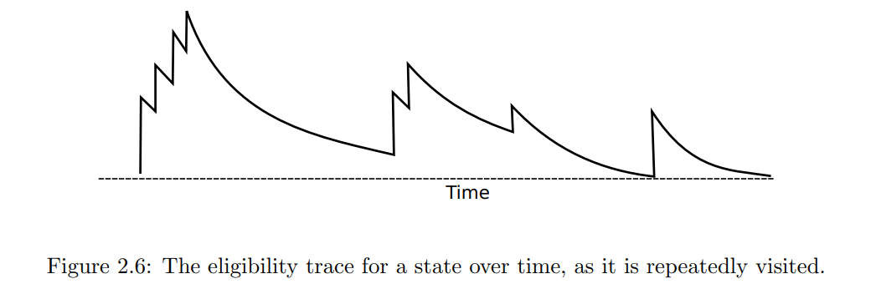
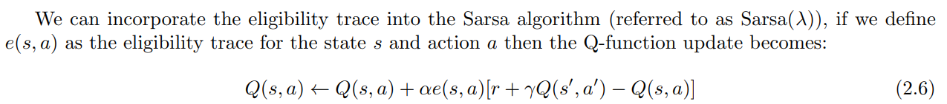
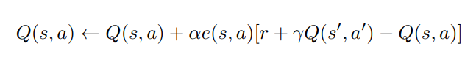
Reinforcement Learning
Eligibility Traces
Notes:
Both the Q-Learning and Sarsa algorithm as described only have one state of lookahead. They only look at the reward at the next time step when updating the Q-function.
But Monte-carlo method have too many steps to update. So N-step TD is developed. And then salsa-gamma is developed.
Eligibility is the key concept of salsa-gamma and implementation of Dopamine- modulated STDP in this paper.
Simply say, the eligibility traces make it possible to incorporate the reward from all future state in our update function.
The eligibility trace for a state keeps a weighted tack of visited to that state in this way we can update previously visited states when we receive a new reward.

Slide 11
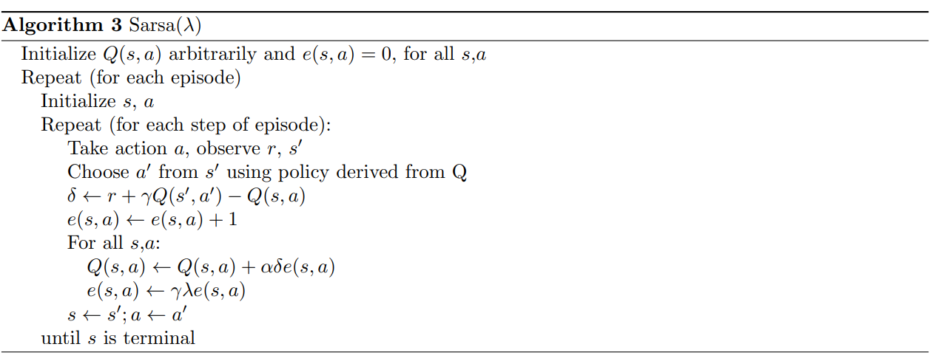
Reinforcement Learning
Eligibility Traces
Notes:
This is algorithm of salsa gamma.

Slide 12
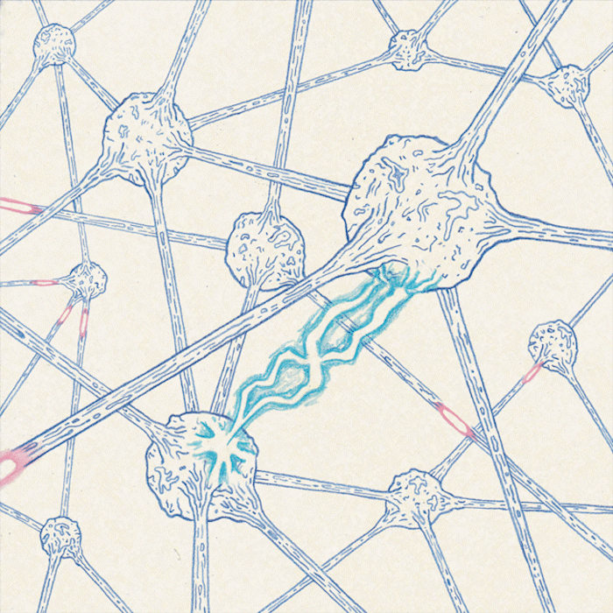
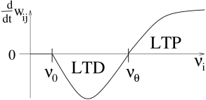
RL in the Brain
BCM Theory
Hebb : “Fire together, Wire together”
→ LTP (long term potentiation)
BCM (Bienenstock, Cooper, Munro)
→ LTD (long term depression)
Notes:
Go next, RL in the Brain.
There are Hebbian theory and BCM theory,
Hebbian Theory claim that an increase in synaptic efficacy arises from a presynaptic cell's repeated and persistent stimulation of a postsynaptic cell. It is an attempt to explain synaptic plasticity, simply say, Fire together, wire together.
But there’s some flaw in Hebbian, and then BCM theory is proposed.
In BCM theory the amount that a synaptic weight changes is dependent on the product of the presynaptic firing rate and a non-linear function φ of the postsynaptic activity.
The effect of this is that if the pre-synaptic neuron is causing a lot of firing in the post-synaptic neuron then the synapse will be potentiated.
Some evidence for the BCM model has been seen in the brain, however it cannot account for synaptic potentiation based on spike timings, which has also been observed in the brain. We can discuss this next slide.

Slide 13
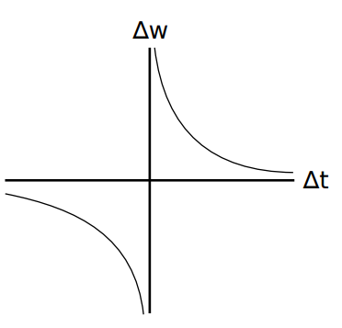
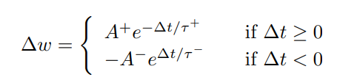
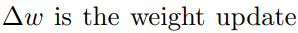
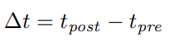
RL in the Brain
STDP (Spike-timing Dependent Plasticity)
Notes:
connections in the brain are modified over time is believed to be spike-timing dependent plasticity, shortly STDP.
The core concept is that neuron connection strength is increased when pre-synaptic activity is followed by post-synaptic activity, and weakened when post-synaptic activity is followed by pre-synaptic activity.
The synaptic weight update rule under STDP is defined as. ~ 변수들 설명
Figure 2.7 shows the relationship between ∆w and ∆t, this shows the window over which STDP can act. Large values of ∆t will have negligible effect on ∆w

Slide 14
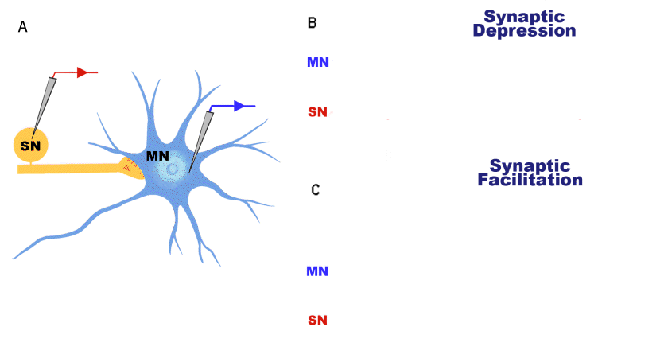
RL in the Brain
STDP
Notes:
STDP can be thought of as an associative learning mechanism. If two inputs to the neural network are often presented together, and in sequence, then the connections from the first input to the second input will become strengthened
Experiments have provided evidence for both STDP and the BCM model in the brain.

Slide 15
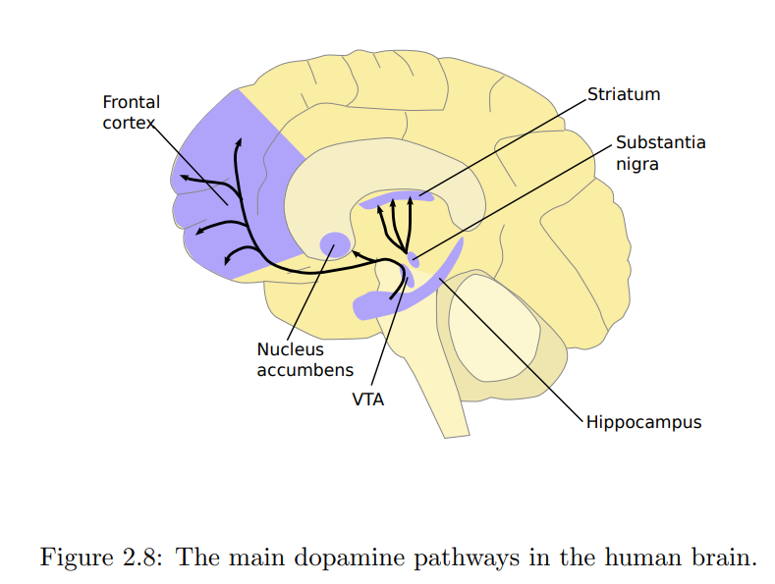
RL in the Brain
Dopamine Modulated STDP
This is the pathway of the dopamine!
Where the most of
dopaminergic neurons are!
(VTA)
Notes:
STDP alone cannot account for the ability of an animal to perform reinforcement learning as it has no concept of reward.
It has been observed that dopamine can modulate synaptic plasticity when it is received within a 15-25s window.
Dopamine in the brain is modulated by way of dopaminergic neurons, these being neurons that use dopamine as their neurotransmitter.

Slide 16
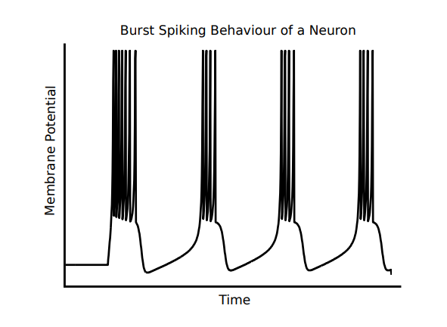
RL in the Brain
Dopamine Modulated STDP
Two different firing pattern(dopaminergic neurons)
Background firing (stimulus X)
Burst firing (stimulus O)
Notes:
STDP alone cannot account for the ability of an animal to perform reinforcement learning as it has no concept of reward.
It has been observed that dopamine can modulate synaptic plasticity when it is received within a 15-25s window.
Dopamine in the brain is modulated by way of dopaminergic neurons, these being neurons that use dopamine as their neurotransmitter.
Maybe I think this researcher choose the ihikevich model instead of LIF model in order to implement dopaminergic neurons.

Slide 17
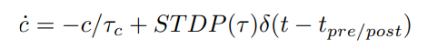
RL in the Brain
Synaptic tag
→ For distal reward problem
decay rate of
the eligibility trace
Dirac delta function
Notes:
In order for dopamine to be able to modulate synaptic plasticity over relatively large time-scales on the order of seconds it has been shown that synapses must have a form of synaptic tag that remembers the activity of the two neurons over a short time..
One of the key problems in reinforcement learning is that the receipt of a reward is often delayed after the action. This is known as the distal reward problem.
STDP as described before works over the millisecond time-scale and so another mechanism is needed to account for this distal reward problem. This is synaptic tag.
synaptic tag increases with the amount of STDP and then decays over time, it is defined as
Where τc defines the decay rate of the eligibility trace, and hence the time-scale over which DA modulation can work. δ(t) is the Dirac delta function and has the effect of step increasing c when STDP takes place. The value of c over time looks very similar to the eligibility trace

Slide 18
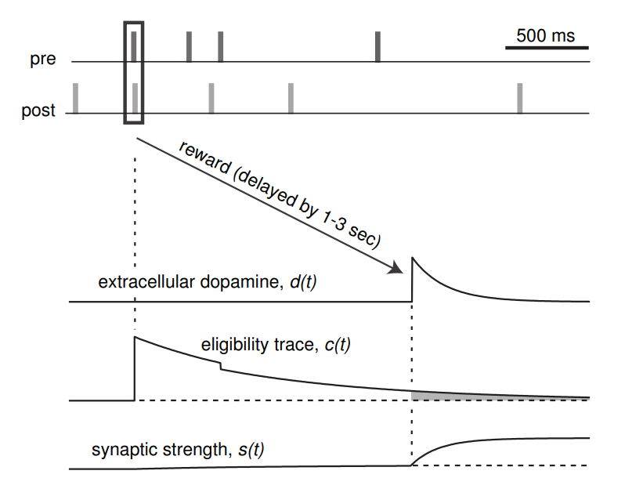
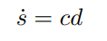
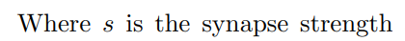
RL in the Brain
Synaptic tag
→ For distal reward problem
Notes:
And synaptic tag is then used to modify the synaptic weight using this formular.
Figure from Izhikevich [1] showing how an eligibility trace can cope with a delayed reward. When the pre then post synaptic neurons coincidentally fire, a delayed reward is received in the form of a spike in dopamine d. This coincident firing increases the eligibility trace c, which slowly decays. It is still positive when the reward is received, and as such the synaptic strength s is increased

Slide 19
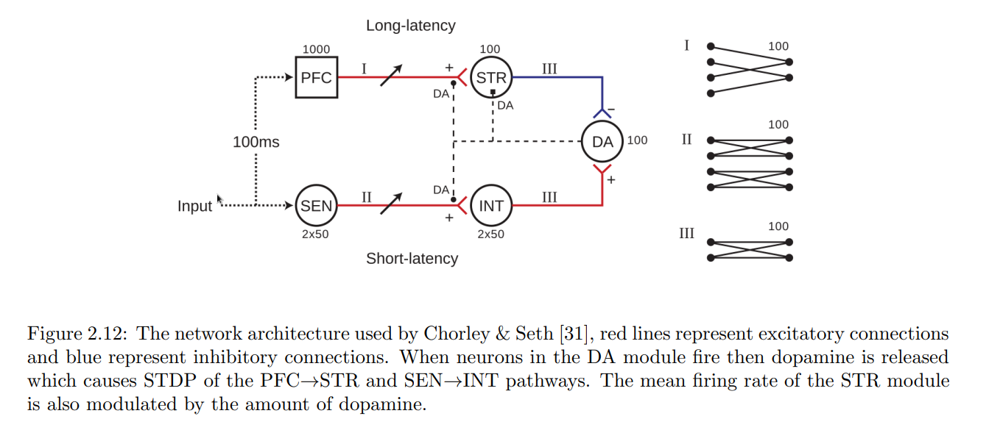
RL in the Brain
Dual-path model
Notes:
Chorley & Seth [31] have incorporated the “dual-path” model [32, 33] into the DA modulated STDP model
In the dual path model there are two pathways between a stimulus and dopaminergic neurons, an excitatory pathway and a time-dependent inhibitory pathway
• DA neurons display phasic activation in response to unexpected rewards [34, 35]. •
These DA neurons display phasic responses to reliably reward-predicting stimuli, yet do not respond to stimuli which are themselves predicted by earlier stimuli [36].
• Reward-related DA responses reappear if a previously predictable reward occurs unexpectedly [36]. •
DA neurons display a brief dip in activity at precisely the time of an expected reward, if that reward is omitted [30].
red lines represent excitatory connections and blue represent inhibitory connections. When neurons in the DA module fire then dopamine is released which causes STDP of the PFC→STR and SEN→INT pathways. The mean firing rate of the STR module is also modulated by the amount of dopamine

Slide 20
Neural encoding
Rate coding
Population coding
Temporal coding
Notes:
In rate coding the strength of the stimulus or output is encoded in the firing rate of a population of neurons. A stronger stimulus emits a faster firing rate
Population coding involves the stimulation of different neurons for different values of the external stimulus. Population coding has the advantage of being able to react to changes in the external stimulus faster than rate coding.
In temporal coding the external stimulus is represented by the precise spike timings in a population of neurons, in this way a greater range of parameters can be represented by the same group of neurons than could be represented with rate coding

Slide 21
Discussion
Out of date(2015)
bridge between RL and SNN
Notes:
아래 두 개는 sergey levine

